Slide 1
ROBUST BIO-SIGNAL STEGANOGRAPHY WITH LOST-DATA RECOVERY ARCHITECTURE USING DEEP LEARNING
MEMBERS:
EKANATHAN S A (202006018)
SAIVIJAY S (202006038)
RAJASEKAR M (202006253)
GUIDE: Dr.G.YOGARAJAN, ME, PhD

Slide 2
AIM
To develop a robust system for encryption and decryption of bio-signal with a focus on lost-data recovery using Deep Learning techniques.
Notes:
2

Slide 3
PROBLEM
Sometimes, the bio-signals may get lost or tampered with during transmission.
SOLUTION
Reconstruction of lost bio-signal with the help of a deep learning approach.

Slide 4
ACRONYMS
PSO – Particle Swarm Optimization
LSTM – Long Short Term Memory
MLPNN – Multi-Layer Perceptron Neural Network
PPG – PhotoPlethysmoGraph
EEG – ElectroEncephaloGraph
ECG – ElectroCardioGraph

Slide 5
OBJECTIVE
To implement a bio-signal encryption process using secret bit insertion.
To design a decryption mechanism secret bit extraction for bio-signal recovery.
To apply PSO algorithm to optimize the position and feature extraction of missed data blocks.
To integrate LSTM and MLPNN to reconstruct missing data blocks during transmission errors.
Notes:
5

Slide 6
NOVELTY
Combination of bio-signal steganography, incorporation of Deep Learning techniques setting it apart from traditional approaches.
Integration of diverse methods within a single framework contributes to the robustness and effectiveness of our bio-signal encryption and recovery system.
Notes:
6

Slide 7
LITERATURE SURVEY ON-DEVICE RELIABILITY ASSESSMENT AND PREDICTION OF
MISSING PHOTOPLETHYSMOGRAPHIC DATA USING
DEEP NEURAL NETWORKS
This paper presents an on-device reliability assessment for Photoplethysmographic (PPG) measurements in ambulatory subjects.
The methodology involves a stack denoising autoencoder (SDAE) and multilayer perceptron neural network (MLPNN) for reliability assessment, with missing segments predicted by a personalized convolutional neural network (CNN) and long-short term memory (LSTM) model.
The PPG Reliability Assessment Model (PRAM) achieves over 95% accuracy in identifying acceptable PPG beats, while the Missing Segment Prediction Model (MSPM) demonstrates effective prediction with a low root mean square error (RMSE) and mean absolute error (MAE).
The integrated device, based on ARM Cortex-A53, features 130 MB memory requirement and 0.35s latency per beat prediction.
M. S. Roy, B. Roy, R. Gupta, and K. D. Sharma, “On-device reliability assessment and prediction of missing photoplethysmographic data using deep neural networks,” IEEE Trans. Biomed. Circuits Syst., vol. 14, no. 6, pp. 1323–1332, Dec. 2020

Slide 8
LITERATURE SURVEY
ON-DEVICE RELIABILITY ASSESSMENT AND PREDICTION OF
MISSING PHOTOPLETHYSMOGRAPHIC DATA USING
DEEP NEURAL NETWORKS
ADVANTAGES:
High Accuracy in Reliability Assessment: The PPG Reliability Assessment Model (PRAM) achieves over 95% accuracy in correctly identifying acceptable PPG beats.
Low Latency and Memory Requirements: The device exhibits low latency and has relatively modest memory requirements, making it efficient and feasible for real-time applications.
DISADVANTAGES:
Discrepancy with Expert Annotations: Despite achieving high accuracy, there is a 3.5% disagreement with expert annotations in identifying acceptable PPG beats.
Limited Historical Data for Missing Segment Prediction.
M. S. Roy, B. Roy, R. Gupta, and K. D. Sharma, “On-device reliability assessment and prediction of missing photoplethysmographic data using deep neural networks,” IEEE Trans. Biomed. Circuits Syst., vol. 14, no. 6, pp. 1323–1332, Dec. 2020

Slide 9
LITERATURE SURVEY SVD-BASED ROBUST IMAGE STEGANOGRAPHIC SCHEME USING RIWT AND DCT FOR SECURE TRANSMISSION OF MEDICAL IMAGES
In the proposed methodology, the Redundant Integer Wavelet Transform (RIWT) is applied for shift-invariant.
Image encryption is achieved using the logistic chaotic map.
Singular Value Decomposition (SVD) and Discrete Cosine Transform (DCT) are combined to optimize imperceptibility.
This comprehensive approach addresses both security and perceptibility concerns in the context of data communication, offering a superior solution.
S. Arunkumar, V. Subramaniyaswamy, V. Vijayakumar, N. Chilamkurti, and R. Logesh, “SVD-based robust image steganographic scheme using RIWT and DCT for secure transmission of medical images,” Measurement, vol. 139, pp. 426–437, Jun. 2019

Slide 10
LITERATURE SURVEY SVD-BASED ROBUST IMAGE STEGANOGRAPHIC SCHEME USING RIWT AND DCT FOR SECURE TRANSMISSION OF MEDICAL IMAGES
ADVANTAGES
Better level of imperceptibility was achieved using SVD and DCT, with embedding carried out on singular values.
Extra security was provided using the logistic chaotic map for encryption of secret medical images, which also enhanced the robustness of the technique
LIMITATIONS
DCT it does not localize the frequency components in space.
S. Arunkumar, V. Subramaniyaswamy, V. Vijayakumar, N. Chilamkurti, and R. Logesh, “SVD-based robust image steganographic scheme using RIWT and DCT for secure transmission of medical images,” Measurement, vol. 139, pp. 426–437, Jun. 2019

Slide 11
LITERATURE SURVEY SECURING DATA IN INTERNET OF THINGS (IOT) USING CRYPTOGRAPHY AND STEGANOGRAPHY TECHNIQUES
The proposed approach in this IoT security-focused paper involves employing Elliptic Galois Cryptography to encrypt confidential medical data from diverse sources.
Subsequently, a Matrix XOR encoding steganography technique is utilized to embed the encrypted data into a visually simple image.
To optimize the selection of cover blocks within the image, an Adaptive Firefly optimization algorithm is applied.
M. Khari, A. K. Garg, A. H. Gandomi, R. Gupta, R. Patan, and B. Balusamy, “Securing data in Internet of Things (IoT) using cryptography and steganography techniques,” IEEE Trans. Syst., Man, Cybern., Syst., vol. 50, no. 1, pp. 73–80, Jan. 2020

Slide 12
LITERATURE SURVEY SECURING DATA IN INTERNET OF THINGS (IOT) USING CRYPTOGRAPHY AND STEGANOGRAPHY TECHNIQUES
ADVANTAGES
Image steganography has a high capacity to carry secret information as it can hide a large amount of data within an image.
Image steganography provides a covert means of communication, as the existence of the secret message is hidden within the image.
LIMITATIONS
Adaptive Firefly optimization algorithm may introduce complexity to the system.
M. Khari, A. K. Garg, A. H. Gandomi, R. Gupta, R. Patan, and B. Balusamy, “Securing data in Internet of Things (IoT) using cryptography and steganography techniques,” IEEE Trans. Syst., Man, Cybern., Syst., vol. 50, no. 1, pp. 73–80, Jan. 2020

Slide 13
COMPARISON
“A Robust Bio-Signal Steganography With Lost-Data Recovery Architecture Using Deep Learning”
Reference paper | Comparison
Deep neural network-based missing data prediction of electrocardiogram signal using multi-agent reinforcement learning | This paper provides a solution for information security in e-health monitoring and cloud storage, addressing the concern of personal information manipulation or leakage. Still, it does not address any data security.
Discrete wavelet transform and singular value decomposition based ECG steganography for secured patient information transmission | It primarily discusses embedding secret information using discrete wavelet transform and singular value decomposition.

Slide 14
COMPARISON
Reference paper | Comparison
Metamorphic cryptography-A paradox between cryptography and steganography using dynamic encryption | It only addresses the challenges related to data hiding and extraction but does not provide a solution for handling data loss during decryption.
Wavelet-based ECG steganography for protecting patient confidential information in point-of-care system | It primarily focuses on ECG signals, It does not multiple types of signals like(ECG, PPG, EEG)
SVD-based robust image steganographic scheme using RIWT and DCT for the secure transmission of medical images | It focuses on image steganography for medical imagery but lacks robustness and uses traditional techniques like Redundant Integer Wavelet Transform(RIWT), Singular Value Decomposition (SVD), and Discrete Cosine Transform (DCT)

Slide 15
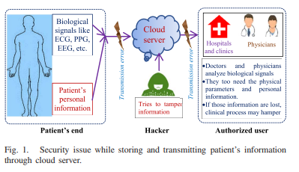


BLOCK DIAGRAM
Biological
Signal like
ECG, PPG,
EEG, etc.
Cloud
server
Cloud
server
Transmission error
Transmission error
Hospitals
and Clinics
Physicians
• Doctors and physicians analyze biological signals. • They too need the physical parameters and personal information. • If those information are lost, clinical process may hamper
Patient’s
Personal
information
Tries to tamper
information
Patient’s end
Hacker
Authorized user
﻿Fig. 1. Security issue while storing and transmitting patient's information through cloud server.

Slide 16




BLOCK DIAGRAM
ENCRYPTION: INSERTION OF SECRET BITS
DECRYPTION: EXTRACTION OF SECRET BITS
Transmission (with information loss in stego-data)
Bio-signal
n
Reconstructed blocks
B₁
B₂
B₃
B₄
n
Secret bit insertion in Hermite space
`B₁
`B₂
`B₃
`B₄
n
Reconstructed Bio-signal
Passkey
Secret-bit
n
Block feature estimation
BT₁
BT₂
BT₃
BT₄
n
B`₁
B`₂
B`₃
B`₄
n
Secret bit extraction in Hermite space
Su-LSTM
Block feature estimation
Stego-data
Ф[B`₁]
Ф[B`₂]
B`₁
B`₂
?
B`₄
n
PSO-Based
estimation
Ф[B`₃]
$Φ$[B`₁]
$Φ$[B`₂]
$Φ$[B`₃]
$Φ$[B`₄ ]
n
Secret bit
Password
BT₁
BT₂
BT₃
BT₄
n
X1
X2
X3
n-1
X2
Hidden byte stream
﻿Fig. 2.Block diagram of proposed steganography algorithm shown for both data insertion and extraction, mentioning data loss during transmission.

Slide 17
ENCRYPTION: INSERTION OF SECRET BITS

Slide 18
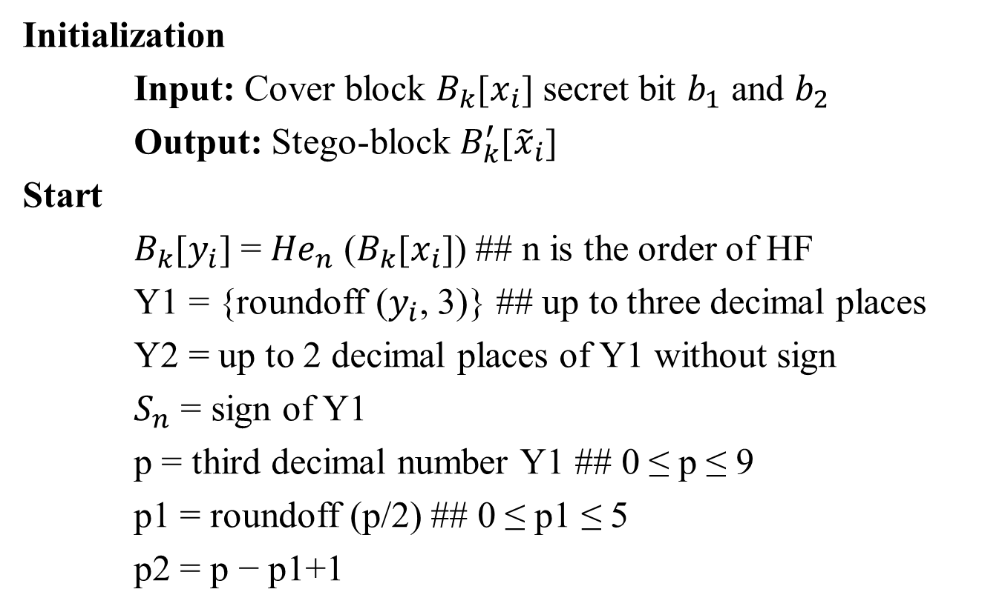
ALGORITHM 1 - Secret Bit Insertion in Hermite Space
Initialization
Input: Cover block $B_{k}$[$x_{i}$] secret bit $b_{1}$ and $b_{2}$
Output: Stego-block $B_{k}^{′}$[${\tilde{x}}_{i}$]
Start
$B_{k}$[$y_{i}$] = ${He}_{n}$ ($B_{k}$[$x_{i}$]) ## n is the order of HF
Y1 = {roundoff ($y_{i}$, 3)} ## up to three decimal places
Y2 = up to 2 decimal places of Y1 without sign
$S_{n}$ = sign of Y1
p = third decimal number Y1 ## 0 ≤ p ≤ 9
p1 = roundoff (p/2) ## 0 ≤ p1 ≤ 5
p2 = p − p1+1

Slide 19

ALGORITHM 1 - Secret Bit Insertion in Hermite Space cont’d..
if $b_{1}$ = = 0 and $b_{2}$ = = 0
$y_{add}$ = 00
$y_{fix}$ = p
else
$y_{add}$= p2 $×$ {($b_{1}×$ 10) + $b_{2}$}
$y_{fix}$ = p1
${\tilde{y}}_{i}$ = $S_{n}×$ {(Y2) + ($y_{fix}×{10}^{−3}$) + ($y_{add}×{10}^{−5}$)}
$B_{k}^{′}$[${\tilde{x}}_{i}$] = ${He}_{n}^{−1}$($B_{k}$[${\tilde{y}}_{i}$])
End

Slide 20
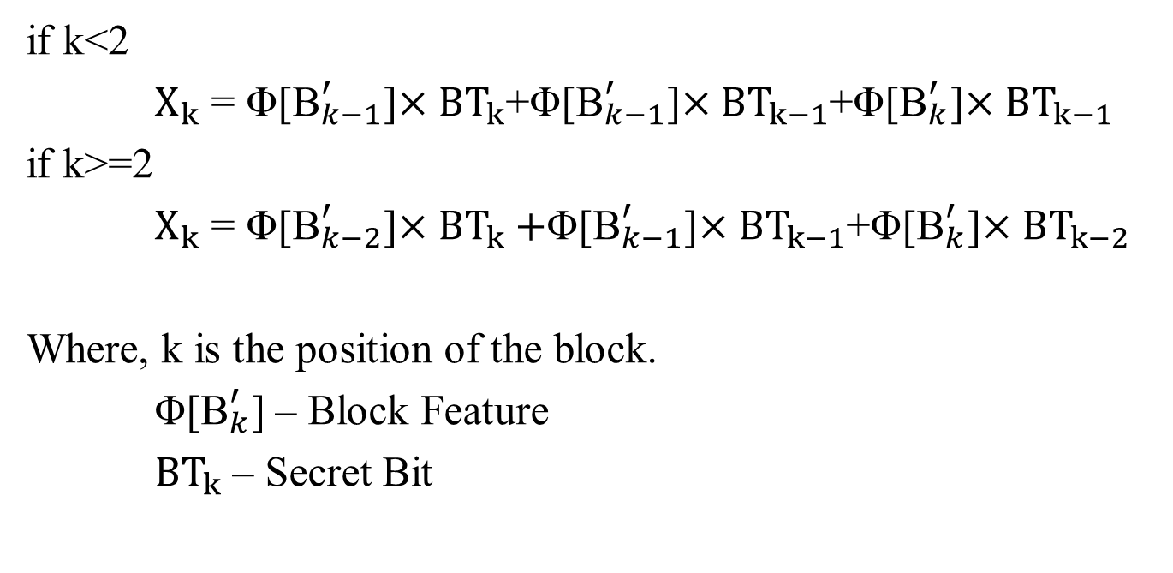
PASSWORD GENERATION
if k<2
$X_{k}$ = Φ[${\text{B}}_{k−1}^{′}$]$×{BT}_{k}$+Φ[${\text{B}}_{k−1}^{′}$]$×{BT}_{k−1}$+Φ[${\text{B}}_{k}^{′}$]$×{BT}_{k−1}$
if k>=2
$X_{k}$ = Φ[${\text{B}}_{k−2}^{′}$]$×{BT}_{k}+$Φ[${\text{B}}_{k−1}^{′}$]$×{BT}_{k−1}$+Φ[${\text{B}}_{k}^{′}$]$×{BT}_{k−2}$
Where, k is the position of the block.
Φ[${\text{B}}_{k}^{′}$] – Block Feature
${BT}_{k}$ – Secret Bit

Slide 21
DECRYPTION: EXTRACTION OF SECRET BITS

Slide 22
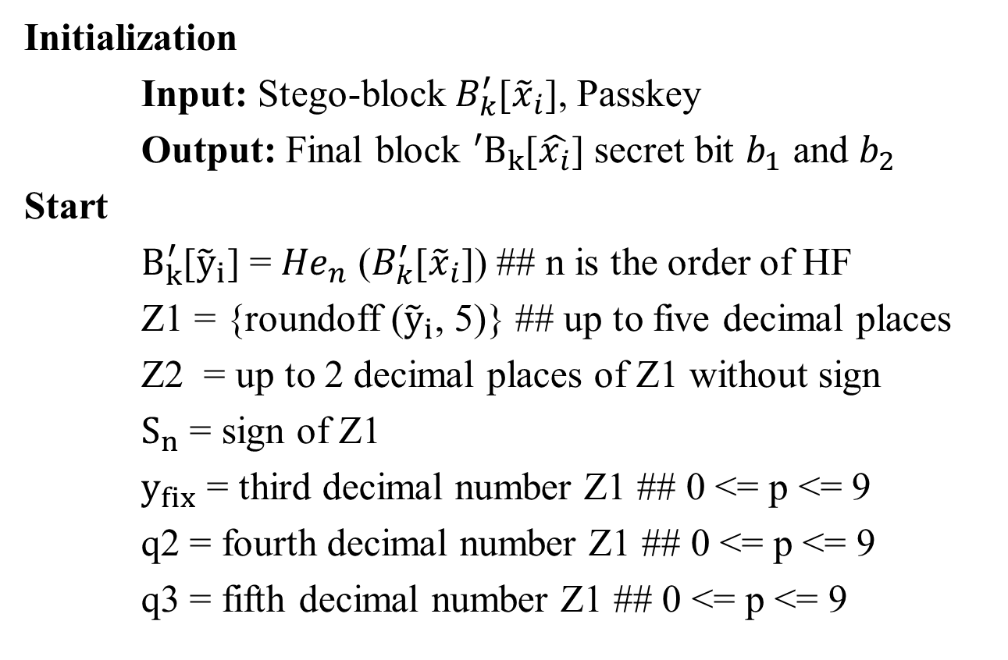
ALGORITHM 2 - Secret Bit Extraction in Hermite Space
Initialization
Input: Stego-block${ B}_{k}^{′}$[${\tilde{x}}_{i}$], Passkey
Output: Final block ${{}_{ }^{′}B}_{k}$[$\hat{x_{i}}$] secret bit $b_{1}$ and $b_{2}$
Start
$B_{k}^{′}$[${\tilde{y}}_{i}$] = ${He}_{n}$ ($B_{k}^{′}$[${\tilde{x}}_{i}$]) ## n is the order of HF
Z1 = {roundoff (${\tilde{y}}_{i}$, 5)} ## up to five decimal places
Z2 = up to 2 decimal places of Z1 without sign
$S_{n}$ = sign of Z1
$y_{fix}$ = third decimal number Z1 ## 0 <= p <= 9
q2 = fourth decimal number Z1 ## 0 <= p <= 9
q3 = fifth decimal number Z1 ## 0 <= p <= 9

Slide 23
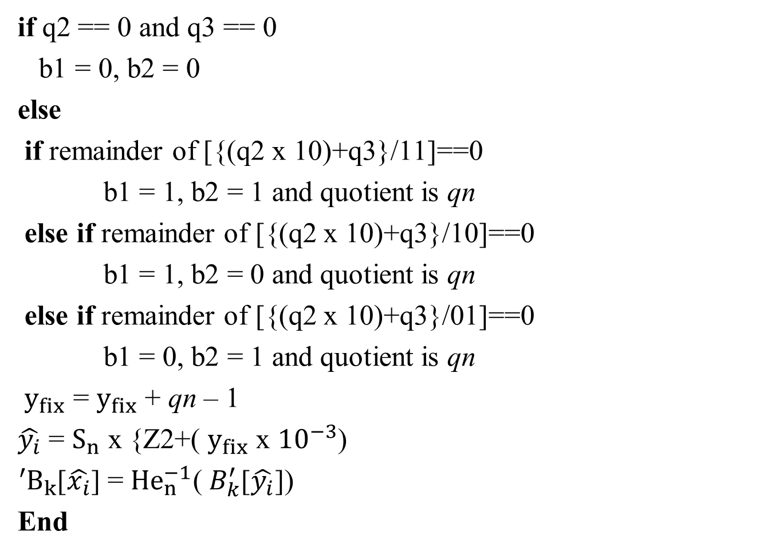
cont’d..
if q2 == 0 and q3 == 0
b1 = 0, b2 = 0
else
if remainder of [{(q2 x 10)+q3}/11]==0
b1 = 1, b2 = 1 and quotient is qn
else if remainder of [{(q2 x 10)+q3}/10]==0
b1 = 1, b2 = 0 and quotient is qn
else if remainder of [{(q2 x 10)+q3}/01]==0
b1 = 0, b2 = 1 and quotient is qn
$y_{fix}$ = $y_{fix}$ + qn – 1
$\hat{y_{i}}$ = $S_{n}$ x {Z2+( $y_{fix}$ x ${10}^{−3}$)
${{}_{ }^{′}B}_{k}$[$\hat{x_{i}}$] = ${He}_{n}^{−1}$(${ B}_{k}^{′}$[$\hat{y_{i}}$])
End

Slide 24
MISSING BYTE AND BLOCK FEATURE ESTIMATION BY PSO

Slide 25
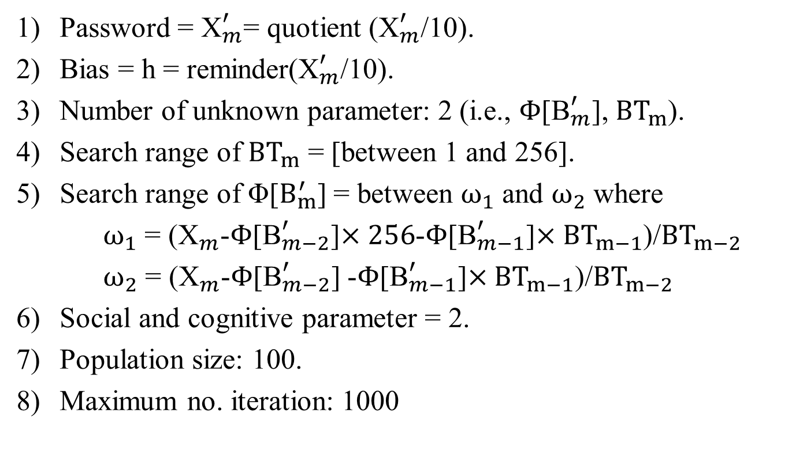
PSO – Parameter Setting
Password = ${\text{X}}_{m}^{′}$= quotient (${\text{X}}_{m}^{′}$/10).
Bias = h = reminder(${\text{X}}_{m}^{′}$/10).
Number of unknown parameter: 2 (i.e., $Φ$[${\text{B}}_{m}^{′}$], ${BT}_{m}$).
Search range of ${BT}_{m}$ = [between 1 and 256].
Search range of Φ[$B_{m}^{′}$] = between $ω_{1}$ and $ω_{2}$ where
$ω_{1}$ = (${\text{X}}_{m}^{ }$-$Φ$[${\text{B}}_{m−2}^{′}$]$×256$-$Φ$[${\text{B}}_{m−1}^{′}$]$×{BT}_{m−1}$)/${BT}_{m−2}$
$ω_{2}$ = (${\text{X}}_{m}^{ }$-$Φ$[${\text{B}}_{m−2}^{′}$] -$Φ$[${\text{B}}_{m−1}^{′}$]$×{BT}_{m−1}$)/${BT}_{m−2}$
Social and cognitive parameter = 2.
Population size: 100.
Maximum no. iteration: 1000

Slide 26
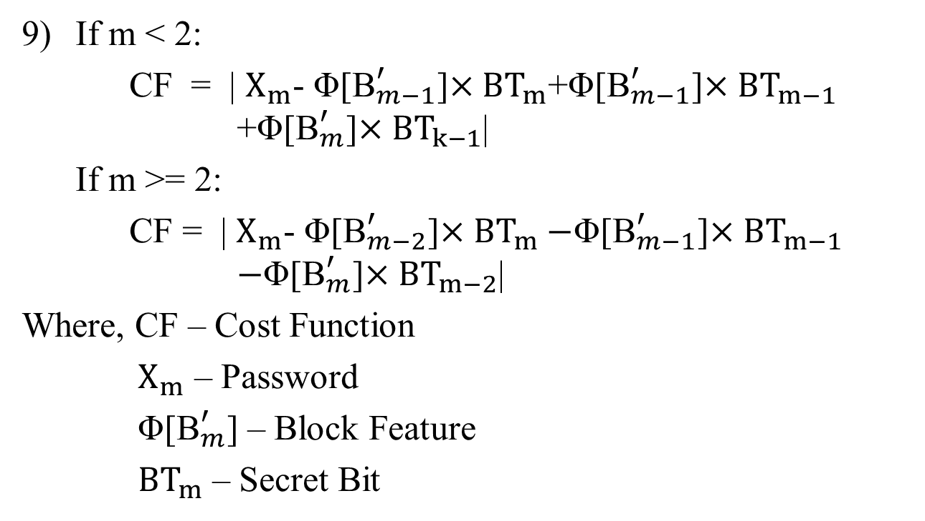
PSO – Parameter Setting
If m < 2:
CF = | $X_{m}$- Φ[${\text{B}}_{m−1}^{′}$]$×{BT}_{m}$+Φ[${\text{B}}_{m−1}^{′}$]$×{BT}_{m−1}$ +Φ[${\text{B}}_{m}^{′}$]$×{BT}_{k−1}$|
If m >= 2:
CF = | $X_{m}$- Φ[${\text{B}}_{m−2}^{′}$]$×{BT}_{m}−$Φ[${\text{B}}_{m−1}^{′}$]$×{BT}_{m−1}$ $−$Φ[${\text{B}}_{m}^{′}$]$×{BT}_{m−2}$|
Where, CF – Cost Function
$X_{m}$ – Password
Φ[${\text{B}}_{m}^{′}$] – Block Feature
${BT}_{m}$ – Secret Bit

Slide 27
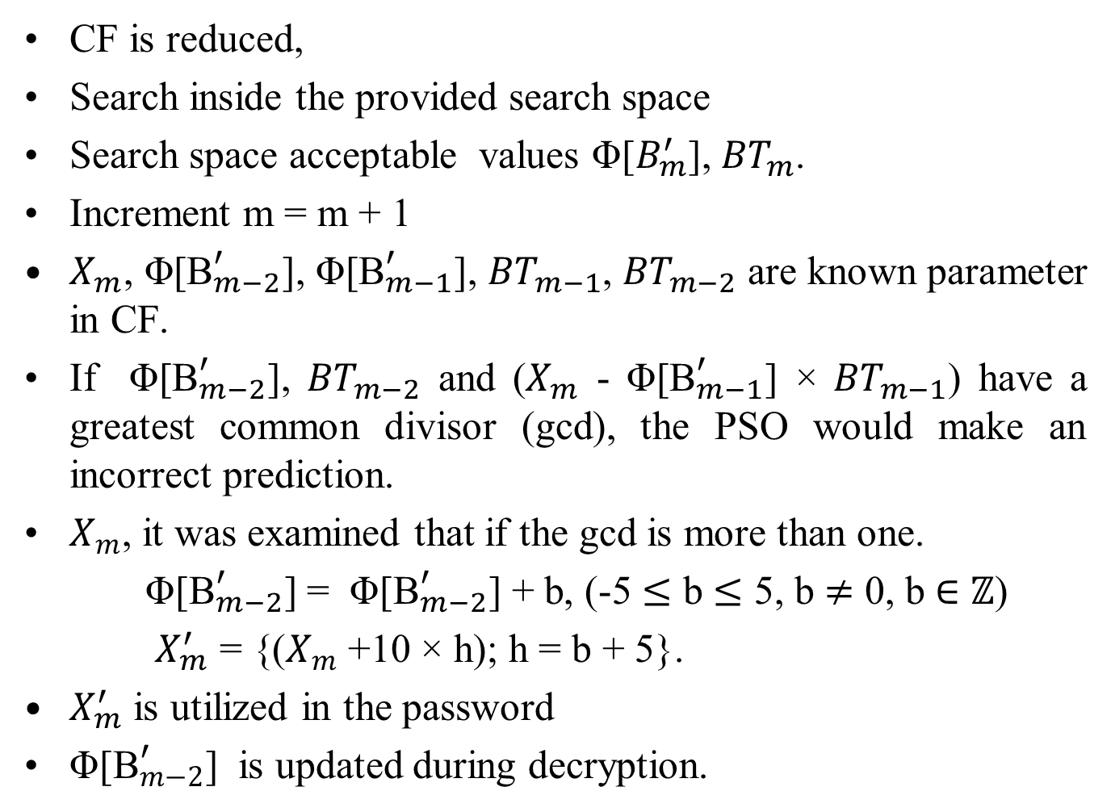
PSO
CF is reduced,
Search inside the provided search space
Search space acceptable values Φ[$B_{m}^{′}$], ${BT}_{m}$.
Increment m = m + 1
$X_{m}$, Φ[${\text{B}}_{m−2}^{′}$], Φ[${\text{B}}_{m−1}^{′}$], ${BT}_{m−1}$, ${BT}_{m−2}$ are known parameter in CF.
If Φ[${\text{B}}_{m−2}^{′}$], ${BT}_{m−2}$ and ($X_{m}$ - Φ[${\text{B}}_{m−1}^{′}$] × ${BT}_{m−1}$) have a greatest common divisor (gcd), the PSO would make an incorrect prediction.
$X_{m}$, it was examined that if the gcd is more than one.
Φ[${\text{B}}_{m−2}^{′}$] = Φ[${\text{B}}_{m−2}^{′}$] + b, (-5 $≤$ b $≤$ 5, b $≠$ 0, b $∈$ $ℤ$)
$X_{m}^{′}$ = {($X_{m}$ +10 × h); h = b + 5}.
$X_{m}^{′}$ is utilized in the password
Φ[${\text{B}}_{m−2}^{′}$] is updated during decryption.

Slide 28
PREDICTION OF LOST STEGO-BLOCK USING SU-LSTM

Slide 29
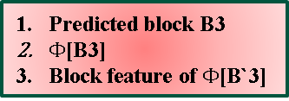
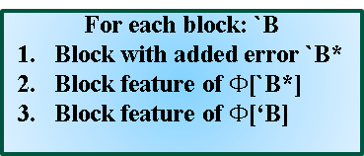

ARCHITECTURE OF SU-LSTM NETWORK
Training
Testing
`B₁
`B₂
`B₃
`B₄
n
Output data from Su-LSTM
Reference data
For each block: `B
Block with added error `B*
Block feature of $Φ$[`B*]
Block feature of $Φ$[‘B]
C_{t-1}
C_{t}
tanh
Input layer
V_{t-1}
F
I
U
O
U_{t}
_{Vt}
MLPNN
LSTM
Input data
B₃
Output from LSTM
Predicted block B3
$Φ$[B3]
Block feature of $Φ$[B`3]
$Φ$[B`₃]
Output from PSO
Fig. 3. Architecture of Su-LSTM network

Slide 30
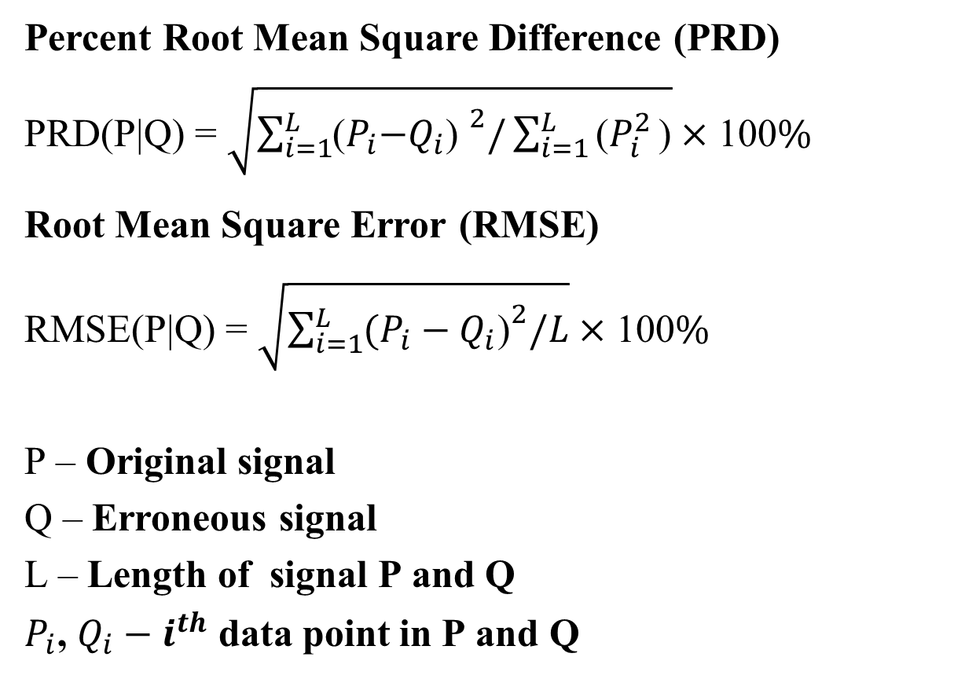
PERFORMANCE INDICES
Percent Root Mean Square Difference (PRD)
PRD(P|Q) = $\sqrt{\sum_{i=1}^{L}{{\text{(}P_{i}\text{−}Q_{i}\text{) }}^{2}/\sum_{i=1}^{L}{\text{(}P_{i}^{2}}}\text{)}}×$ 100%
Root Mean Square Error (RMSE)
RMSE(P|Q) = $\sqrt{\sum_{i=1}^{L}{{(P_{i}−Q_{i}\text{)}}^{2}/L}}×$ 100%
P – Original signal
Q – Erroneous signal
L – Length of signal P and Q
$P_{i}$, $Q_{i}−i^{th}$ data point in P and Q

Slide 31
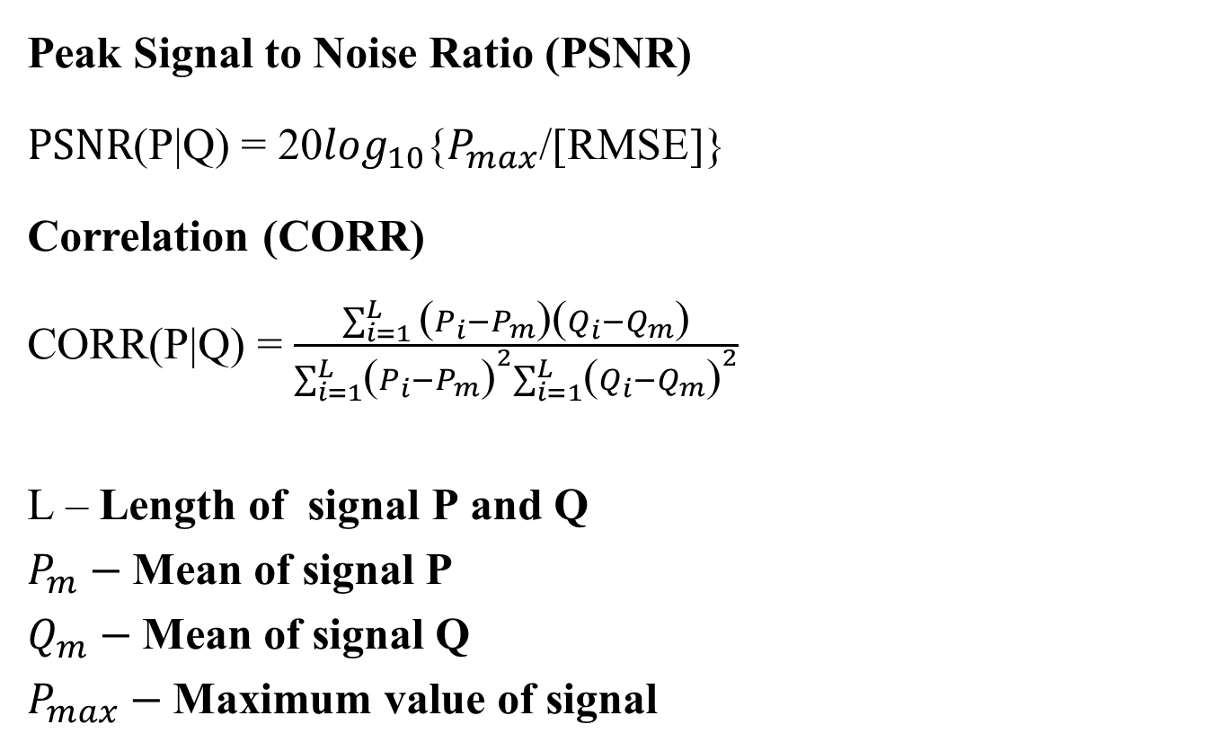
PERFORMANCE INDICES
Peak Signal to Noise Ratio (PSNR)
PSNR(P|Q) = 20$\log_{10}${$P_{max}$/[RMSE]}
Correlation (CORR)
CORR(P|Q) = $\frac{\sum_{i=1}^{L}{\text{(}P_{i}−P_{m}\text{)(}Q_{i}−Q_{m}\text{)}}}{\sum_{i=1}^{L}{{\text{(}P_{i}−P_{m}\text{)}}^{2}\sum_{i=1}^{L}{{\text{(}Q_{i}−Q_{m}\text{)}}^{2}}}}$
L – Length of signal P and Q
$P_{m}−$Mean of signal P
$Q_{m}−$Mean of signal Q
$P_{max}−$Maximum value of signal
=
1

Slide 32
DATA SET
ECG Dataset
DATA SETS\ECG.xlsx
PPG Dataset
DATA SETS\PPG-BP dataset.xlsx
EEG Dataset
DATA SETS\SMNI_CMI_TEST.rd.099

Slide 33
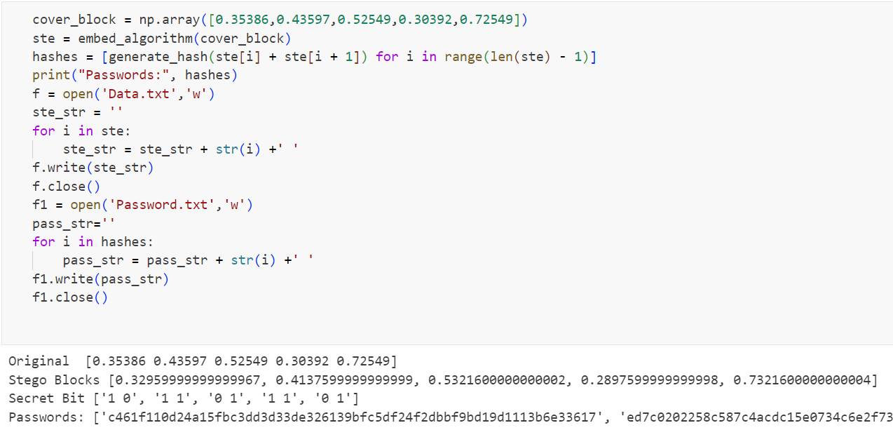
SECRET BIT INSERTION PASSWORD GENERATION

Slide 34
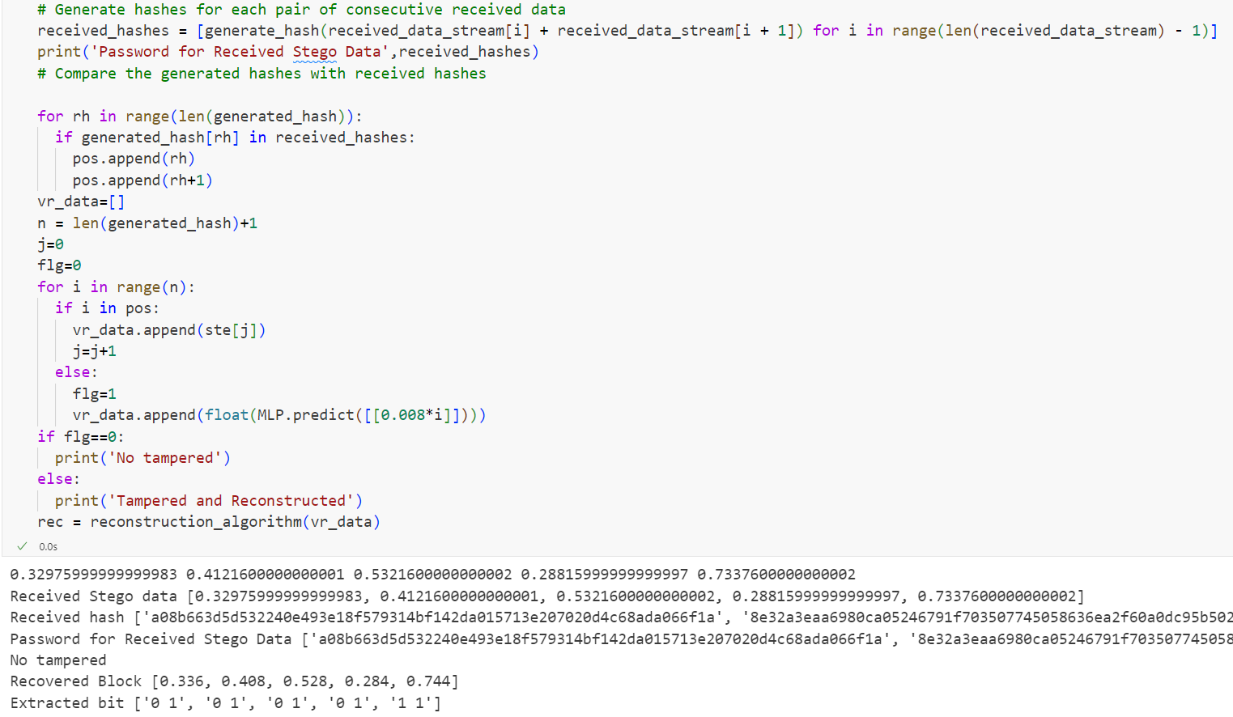
SECRET BIT EXTRACTION CASE 1: WITHOUT TAMPERING

Slide 35
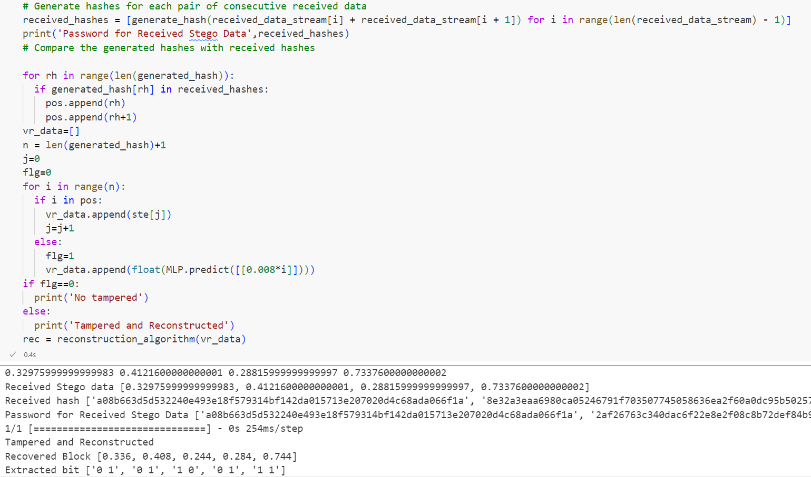
SECRET BIT EXTRACTION CASE 2: WITH TAMPERING

Slide 36
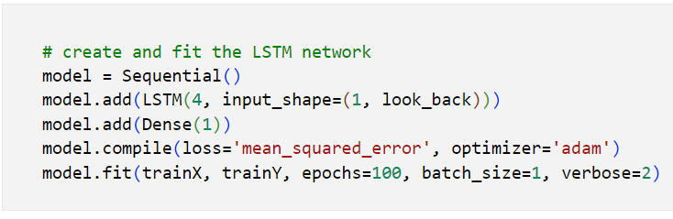
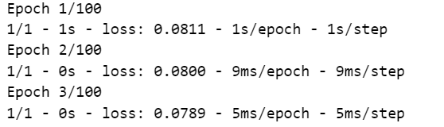
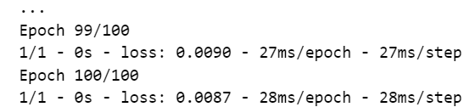
LSTM TRAINING

Slide 37
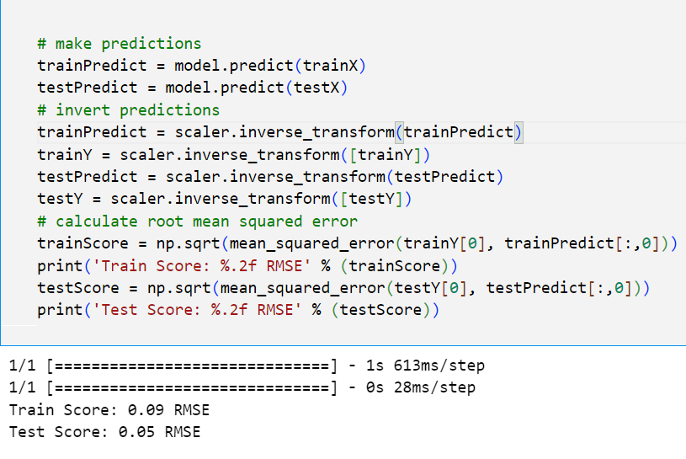
RMSE - LSTM

Slide 38
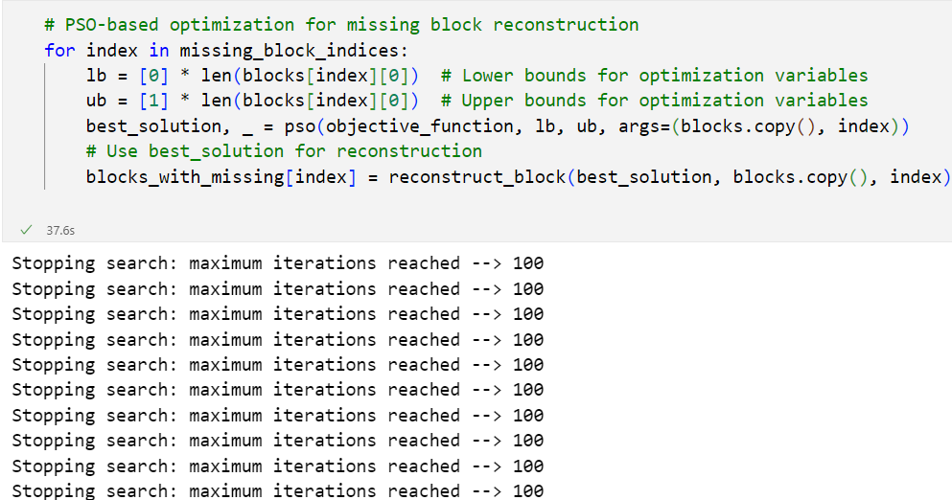
PSO – OPTIMIZATION

Slide 39
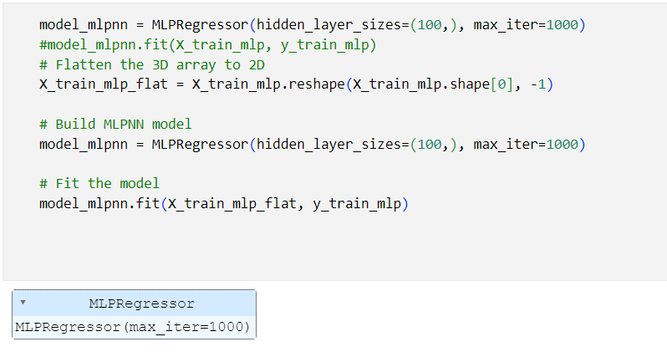
MLPNN MODEL

Slide 40
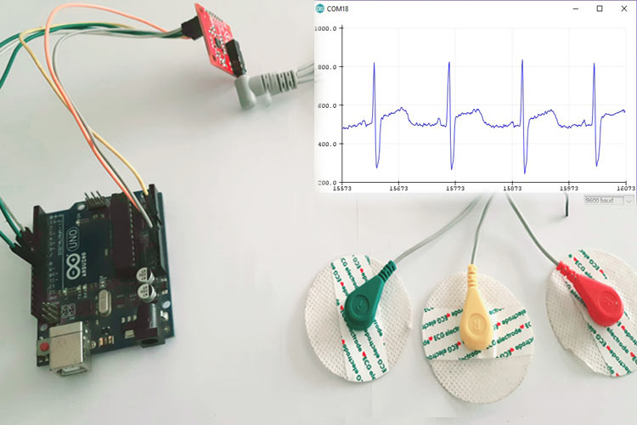
HARDWARE SETUP

Slide 41
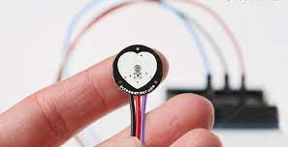
HARDWARE SETUP
PPG SIGNAL SENSOR

Slide 42
References
[1] S. Arunkumar, V. Subramaniyaswamy, V. Vijayakumar, N. Chilamkurti, and R. Logesh, “SVD-based robust image steganographic scheme using RIWT and DCT for secure transmission of medical images,” Measurement, vol. 139, pp. 426–437, Jun. 2019.
[2] M. Khari, A. K. Garg, A. H. Gandomi, R. Gupta, R. Patan, and B. Balusamy, “Securing data in Internet of Things (IoT) using cryptography and steganography techniques,” IEEE Trans. Syst., Man, Cybern., Syst., vol. 50, no. 1, pp. 73–80, Jan. 2020.
[3] S. Banerjee and G. K. Singh, “Deep neural network based missing data prediction of electrocardiogram signal using multiagent reinforcement learning,” Biomed. Signal Process. Control, vol. 67, May 2021, Art. no. 102508.
[4] S. E. Jero, P. Ramu, and S. Ramakrishnan, “Discrete wavelet transform and singular value decomposition based ECG steganography for secured patient information transmission,” J. Med. Syst., vol. 38, no. 10, pp. 1–11, Oct. 2014.

Slide 43
References
[5] J. T. L. Philjon and N. V. Rao, “Metamorphic cryptography—A paradox between cryptography and steganography using dynamic encryption,” in Proc. Int. Conf. Recent Trends Inf. Technol., Jun. 2011, pp. 217–222.
[6] A. Ibaida and I. Khalil, “Wavelet-based ECG steganography for protecting patient confidential information in point-of-care systems,” IEEE Trans. Biomed. Eng., vol. 60, no. 12, pp. 3322–3330, Dec. 2013
[7] N. Soni, I. Saini, and B. Singh, “An integer wavelet transform and pixel value differencing based feature specific hybrid technique for 2D ECG steganography with high payload capacity,” Multim. Tools Appl., vol. 80, pp. 8505–8540, Mar. 2021.

Slide 44
THANK YOU
Notes:
44

